Slide 1
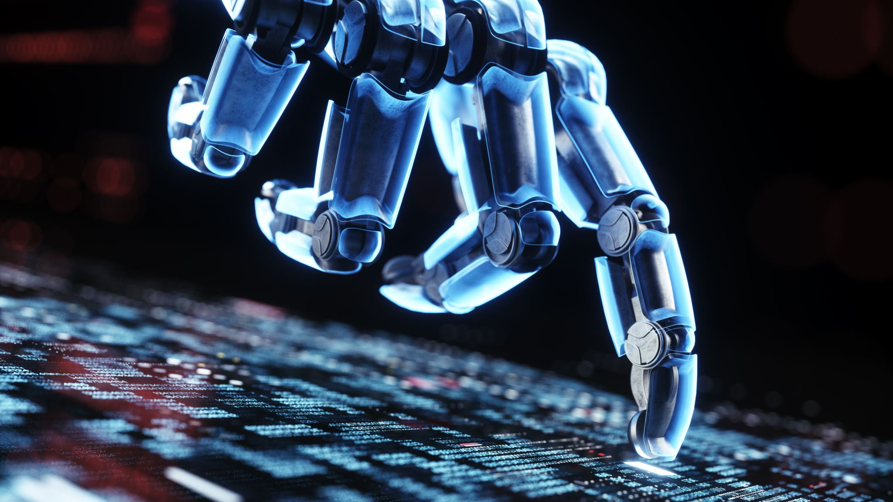
MACHINE LEARNING A FACE OFF OF EMOTIONS
By: Johnny Capra, Laura Dudley,
Ian Morrison, & Lucas Chacon
Notes:
Lucas:
For our final project, we decided to work with images and computer vision to train a machine learning model. One of the most common applications of computer vision is facial detection, which is utilized in everything from digital cameras (remember those?) to smartphone security and social media tagging. We wanted to take this element of computer vision a bit further by trying to train a machine learning model to identify emotions in images of faces. While humans in general are pretty good at recognizing facial emotions, it can be challenging for autistic and other neurodivergent people to do so without extra effort and training. Since humans can learn how to better identify emotions by taking patterns and extrapolating from those patterns, the process seems well designed for a machine learning model too.

Slide 2
Emotion Prediction - Our Dataset
35k+ black & white images (https://www.kaggle.com/datasets/chiragsoni/ferdata/data)
The composition of these images were based off a 2013 dataset prepared by Pierre-Luc Carrier and Aaron Courville as part of a research project (https://datarepository.wolframcloud.com/resources/FER-2013)
Each image is categorized into one of 7 emotional states: anger, disgust, fear, happiness, sadness, surprise, and neutral
Notes:
We found a large dataset of black & white images of faces depicting various emotions: anger, disgust, fear, happiness, sadness, surprise, and neutral or no emotion and used it to train our model. This dataset was based off a 2013 dataset prepared by Pierre-Luc Carrier and Aaron Courville as part of a research project.

Slide 3







Emotion Prediction - Our Dataset
Faces are centered and without extraneous objects in the image.
48x48 pixels (approximately 1-2 KB per image)
This reduces the amount of information the model needs to work through (although it’s still a lot!)
Notes:
The faces are centered and without extraneous objects in the image. The images are also uniform in dimension - 48 pixels by 48 pixels - and in black & white. This reduces the amount of information needed to encode each image, and subsequently the amount of information for the model to process. With over 35,000 images, however, we still had a lot of information!
(pass to Johnny)

Slide 4
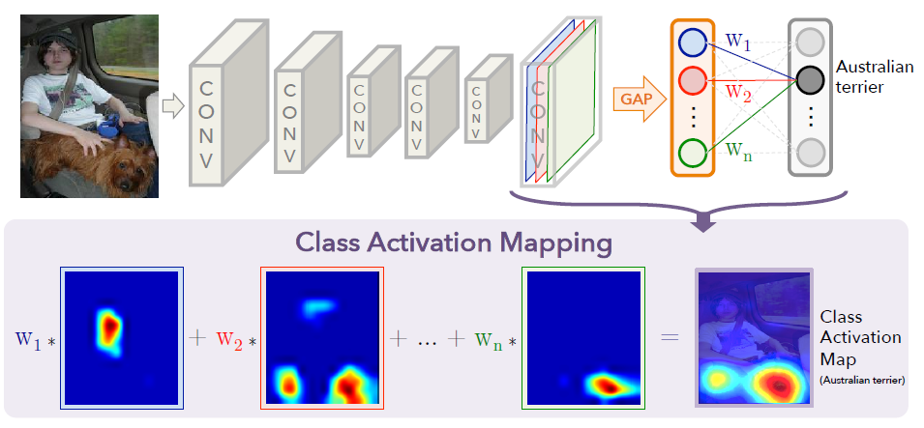
Training & Refining the Model
80% of the images were used for training
10% were used for refining the model
10% were used for testing
Convolutional neural network model using Tensorflow & Keras
Notes:
Johnny:
The majority of the images (80%) were used for training, with the remaining 20% used for refining the model and testing the model after the initial training. Our machine learning model is a convolutional neural network (CNN), and we used 3 convolutional layers, built using Tensorflow and Keras. We then tuned the model using a Keras tuner called Hyperband.
Image passes through convolution layers, global average pooling giving single value, weighted summation (weighted importance), normalization, and visualization heat map of activation values over input image

Slide 5
Training Process
3 Convolutional Layers:
Layer 1: applied filters and specified shape & grayscale channel
Layer 2: applied twice as many filters to previous layer
Layer 3: applied 4 times as many layers as first layer
In between were Max Pooling Layers, which reduced the spacial dimensions and extracted the most important features of each layer
Flatten and dense layers
Notes:
The model was run with 3 convolutional layers, with a max pooling layer after each convolutional layer.
Layer 1: applied filters and specified shape & grayscale channel
Layer 2: applied twice as many filters to previous layer
Layer 3: applied 4 times as many layers as first layer
The max pooling layers reduced the spacial dimensions and extracted the most important features of each layer.
Flatten Layer: This layer flattens the 3D output tensor from the convolutional layers into a
1D tensor, which can be fed into the subsequent fully connected layers

Slide 6
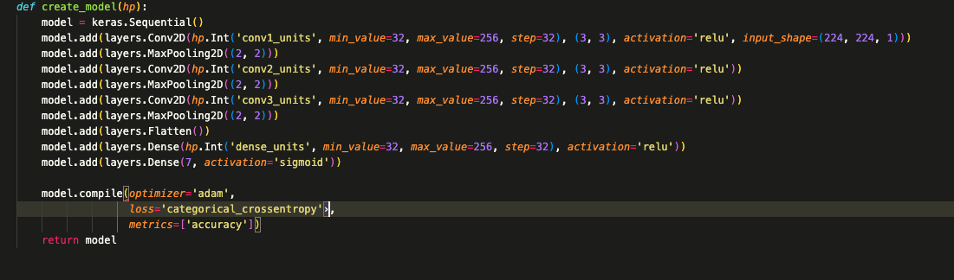
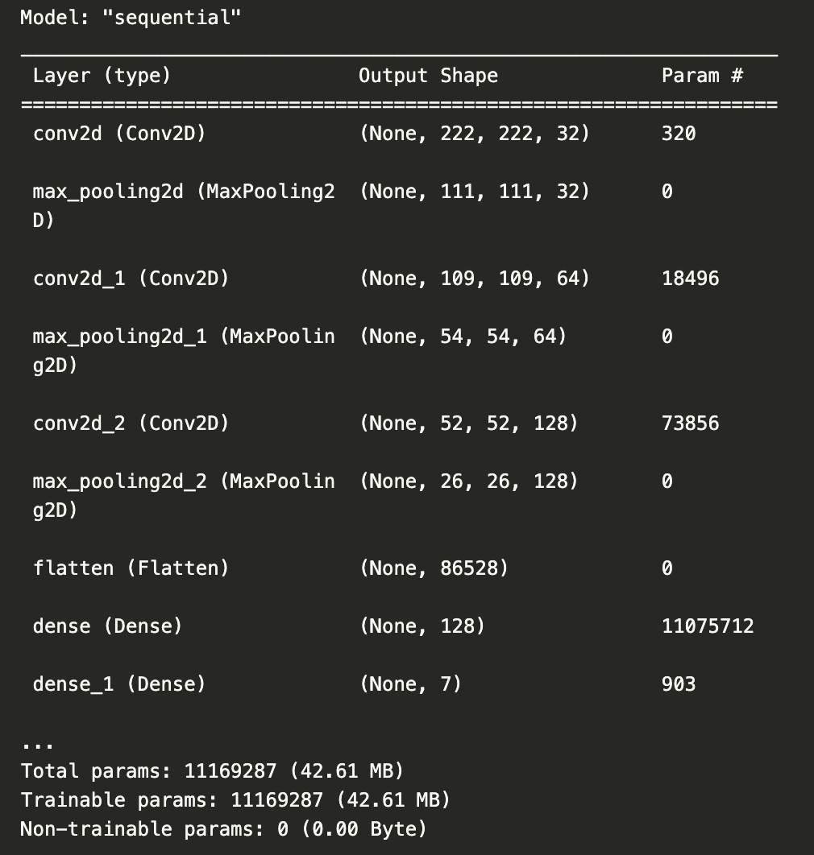
Comparing models
Tuned Model
Regular Model Summary
Notes:
Differences between tuner vs regular
Explain why relu was used and sigmoid
Sigmoid is good for interpreting probabilities
minimum number of filters that the layer can have
maximum number of filters that the layer can have
specifies the step or increment size for the search space. It determines the granularity of the search for the hyperparameter. In the context of the number of filters for the Conv2D layer, this specifies how many filters to skip between each search point.
Johnny - testing and tuning discussion, then pass to Laura

Slide 7
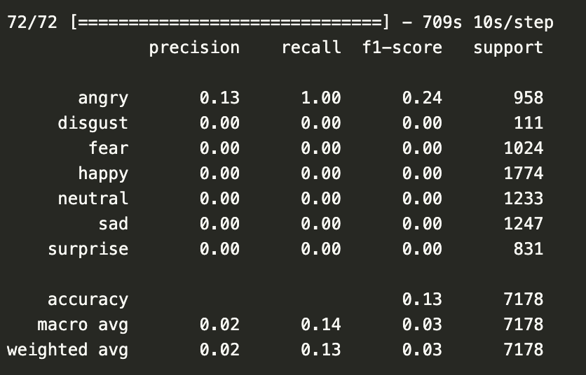
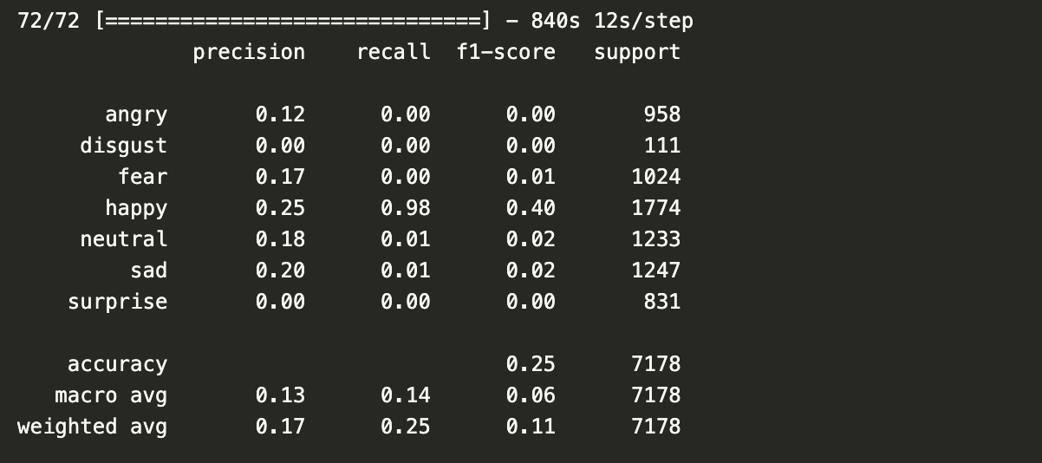
Testing & Tuning Our Model
Binary Crossentropy
Categorical Crossentropy
Notes:
Explain difference between binary and categorical
Precision: The ratio of true positives to the sum of true positives and false positives. It indicates the proportion of positive predictions that were actually correct.
Recall: The ratio of true positives to the sum of true positives and false negatives. It indicates the proportion of actual positive instances that were correctly predicted by the model.
F1 Score: The harmonic mean of precision and recall. It provides a single score that balances both precision and recall.
Support: The number of actual occurrences of the class in the specified dataset. It represents the number of instances in each class.

Slide 8
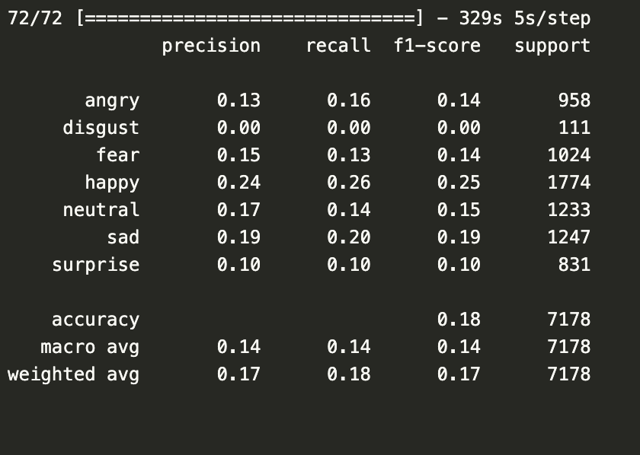

Comparing Results
Regular Model
Tuned Model
Notes:
Johnny - Explain different test scores,
testing and tuning discussion, then pass to Laura

Slide 9
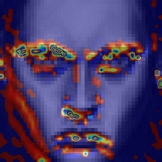
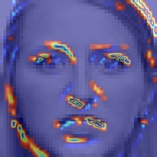
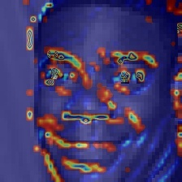
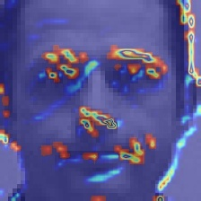
Successes & Challenges
Heatmaps showing the areas of focus for the model after the last convolutional layer
Notes:
Laura:
We generated heatmaps showing the areas focused on by the model, which give a great visual representation of the way the model learned to focus on the areas of a face with the most information. Since expression is conveyed by a combination of eyes, eyebrows, lips and even the nose, it’s interesting to see the way the model learned to focus on these elements after 3 convolutional layers.
Our model has been successful at predicting both anger and happiness, however it appears to need more training and tuning for the other emotions. Unfortunately, we ran out of time to continue improving the model.

Slide 10
Successes & Challenges
Time Intensive
The model took a long time to run!
8-12 hours initially, and never less than 5 hours
This limited the number of times we could test and tune our model
Uncertain Dataset
It’s hard to be certain of the dataset’s quality, without reviewing the images in more detail.
Not Randomized
Possible sequential bias, since the images weren’t shuffled
Notes:
Laura:
Sequential Bias: If the training data is presented to the model in a fixed order without shuffling, the model may develop a bias towards patterns or trends present in the data sequence. For example, if similar instances are grouped together in the dataset, the model might learn to prioritize certain patterns over others, potentially leading to overfitting on specific subsets of the data.
Learning Dynamics: The order in which data is presented can influence the trajectory of the model's optimization process. In stochastic gradient descent (SGD), for example, the model's parameters are updated incrementally based on small batches of data. The order in which these batches are sampled can affect the convergence behavior and the final solution reached by the optimization algorithm.
Generalization Performance: The order of input data can impact the model's ability to generalize to unseen examples. If the training data is presented in a biased order that does not adequately represent the true distribution of the data, the model may struggle to generalize well to new, unseen instances.
(Pass to Ian)

Slide 11
Current & Future Applications
The Emergence of this Technology
The Large Role Facial Recognition is Taking on as the Technology Evolves
Mobile Phones
Shoplifting - i.e. Target
Terrorist Hunting - Berlin
Military Detection - Pinpoint Accuracy
We Decided to Take on This Concept & See How Far We Could Push These Limits
We All Understood the Premise Behind the Recognition of a Face
Symmetrical Patterns & Variations
Placement of Facial Characteristics
We Wanted to Explore the Limitations of Recognizing Not Just a Face, But an Emotion
Notes:
Ian:
Overall, this was an interesting first foray into computer vision, and we can see several ways in which this model can be refined for different uses. It could help to predict the emotions in a crowd by scanning security cameras, or be used as an aid in helping neurodivergent people train their brains to work with emotions. It could even be used as a way for actors to refine their emoting ability, by giving feedback on how well they express a target emotion. There are always ethical implications with machine learning, and that’s even more true with facial information, so any future uses or applications should always be considered thoroughly and carefully before being implemented.
We have everyday examples of how this has already been seamlessly implemented into our everyday lives.
A glaringly obvious example of this are our phones. Most of them require your face to unlock. For awhile, you needed a fingerprint if you didn’t want to manually enter a code in every time.. Funny how long that lasted before jumping to the now present facial recognition system. I wonder how long they get to keep the data of our fingerprints for? But as I’m sure you’ve all noticed, theres a level of emotional facial recognition there too. If you make a strange face or alter it in any dramatic way from the normal double chin blank look down stair, the phone won’t unlock. That similar software and machine learning to the emotional facial recognition we’ve discussed here today.
As you may have noticed, self checkout stations have implemented every store still standing. Most prominently grocery stores. And every station has a recording camera of your face. Stores like Target and Walmart have already taken these measures and escalated the use of this technology to the next level. Aware of the tendency for people to try to take advantage of the honor system with self check out have strong store policies to not confront or chase down shoplifters. Both Walmart and target haveloss prevention officers at every store that watch for shoplifters. They are on the floor and in the back watching everyone on camera, and in teh self checkout lanes. They will tag faces of repeat offenders of individuals who continuously “miss scans” at self check out. And in some cases have used the cameras to track to your parked car and taken down license plate information. Another very recent example in our everyday lives just happened in Berlin where a terrorist by the name of Daniela Klette was just caught after evading attorities since the 1980’s. Daniela was part of the Red Army Faction terrorist network, RAF for short. The group is believed to have been responsible for 30 murders and injuring 200.
She was involved in at least 10 armed attacks and robberies, including a gun attack on the US embassy in 1991. The group disbanded in 1998 and everyone went underground on the run. Since then shes has been involved in another 10 armed robberies and an attempted murder between 1999-and 2016. Known by her community as the neighborhood dog walker. Daniela was photographed while at a festival intown. A journalist was using an AI facial recognition system when developing the pictures. And the AI kept coming up with two names for Danilas image. Her alias of the last 20 years and her name. Shes been in the top most wanted terrorist for germany for the last 3 decades and was caught in plain sight using facial recognition by a journalist who reported it to authorities who then confirmed.
Even drone footage shows they can accurately pick up all the information on the screen of your cell phones from 30 thousand feet up.

Slide 12
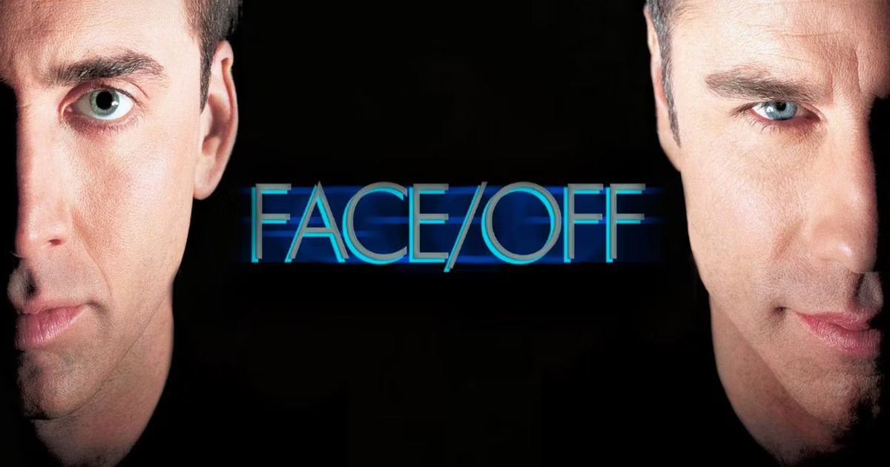
THE SEQUEL?!?!
NO, JK JK
Notes:
Ian’s Slide
Which leads us to the real reason behind this presentation, Our group will be producing the sequel 1997 blockbuster hit
For those who haven’t seen it, a film starring nicolas cage and john travolta, about a detective and a terrorist who use state of the art procedures to swap faces and end up fooling everyone on both sides. Something potentially useful in the future maybe, no just me, anyways.. ?
In all seriousness, the idea of Facial recognition has been around for awhile even if the science is just starting to publicly catch up. Theres that old saying that any new technologies we have today, have been held by the government/military for the last 5 to 10 years prior. Maybe thats why we’ve become a bit unaware of all the facial recognition in todays world.. We’ve been perhaps to some degree a bit desensitized to it all. Seeing it from films like V for Vendetta, or iRobot, or almost any syfi movie of the last 40 years, where participation within a futuristic society comes with the forced obligation of registering your facial features to be instantaneously tracked. But this is all for the common welfare and safety of everyone, right. This could never be manipulated or taken advantage of. Our polliticans and government would never do such a thing… haha I say this in a forced humor of plain relevance. Through accommodation and convenience we tend to quickly forget the moral and ethical implications to unanimously adopted decisions like this..
With advancements like Apples Vision Pro goggles, real time, mobile facial recognition is just a few steps away from being a public commodity let alone one handled by a local and federal governments. Hell, when you go to london, theres a common expression that you can’t go one block without being caught by sever cameras.
There are other ways we are tracking into the future. Maybe we head into a world reflected in that of the film from 2001 called Vanilla sky starring tom cruise where retina recognition is tracked through every aspect in life. This goes beyond just the cinematic imagination.. Amazon has installed palm reading and retna reading devices in some of their stores and whole foods locations. Other Amazon Fresh stores where you scan one of these items (be it your hands, eyes, face), or your phone, and the cameras in real time watch roam the store and track everything you take off the shelves and everything you put back and ultimately what you end up leaving with. All automatically charging your account without one single transaction, interaction or scan taking place. Well, other than the scanning of your face, and body movements as you roam through the store their digital realm.
Or perhaps we take this to the printed pages of George orwell's famous novel, 1984. That was also published in 1984, where orwell describes a society thats always watching.. and i quote. “They're watching your every move, and they'll report you if you even make a wrong facial movement.”

Slide 13
Any Questions?

Slide 14
References
For the Dataset- https://www.kaggle.com/datasets/chiragsoni/ferdata/data?select=test

